Slide 1

Glance at Reinforcement Learning
Adam Green September 2017 adgefficiency.com
Notes:
Focus on key concepts – the field goes much deeper
Shouldn’t expect to learn everything
Its ok if you don’t grasp everything!

Slide 2
Introduction
I blog about energy & machine learning at adgefficiency.com
Background in energy engineering
B.Eng chemical, MSc process design for energy
4 years technical energy modelling for ENGIE in the UK
DSR Batch 09 - reinforcement learning for energy systems
Now at Tempus Energy - Energy Data Scientist
Supervised learning to predict prices
Reinforcement learning to control flexibility assets
Notes:
Focus on key concepts – the field goes much deeper
Shouldn’t expect to learn everything
Its ok if you don’t grasp everything!

Slide 3
Goals for today
One - Introduction to reinforcement learning
Two - Value function methods
Literature review – Learning to play Atari (2013)
Three - Policy methods
Literature review – Mastering the game of Go (2016)
Notes:
Focus on key concepts – the field goes much deeper
Shouldn’t expect to learn everything
Its ok if you don’t grasp everything!

Slide 4
Nomenclature
For a problem with 3 state variables, 2 actions
s = state [s₁, s₂, s₃]
s’ = next state [s₁, s₂, s₃]
a = action [a₁, a₂]
r = instantaneous reward
G = return
π = policy
π * = optimal policy
v(s) = value function
Q(s,a) = action-value function
θ, w = weights/fctn parameters
Notes:
Focus on key concepts – the field goes much deeper
Shouldn’t expect to learn everything
Its ok if you don’t grasp everything!

Slide 5
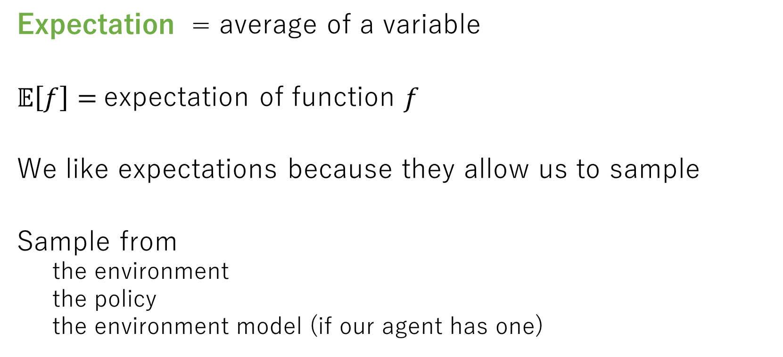
Expectations
Expectation = average of a variable
$𝔼\left[f\right]=$expectation of function $f$
We like expectations because they allow us to sample
Sample from
the environment
the policy
the environment model (if our agent has one)
Notes:
Focus on key concepts – the field goes much deeper
Shouldn’t expect to learn everything
Its ok if you don’t grasp everything!

Slide 6
Conditionals
Conditional = probability of one thing given another
P(s’ | s, a) = environment state transition function
probability of s’ given s, a
R(s, a, s’) = reward function
reward received after being in state s, taking action a, ending up in s’
π(a| s) = policy
action chosen in state s
Notes:
Focus on key concepts – the field goes much deeper
Shouldn’t expect to learn everything
Its ok if you don’t grasp everything!

Slide 7
Course material from
RL Course by David Silver
15 hours of UCL lectures by DeepMind lead programmer
Sutton & Barto – Reinforcement learning: An Introduction
Bible of Reinforcement learning
Deep Reinforcement Learning (John Schulman, OpenAI)
youtube lecture
Notes:
Focus on key concepts – the field goes much deeper
Shouldn’t expect to learn everything
Its ok if you don’t grasp everything!

Slide 8
Definitions
Variance
error from sensitivity to noise in data set
model is too complex
model can see patterns that aren’t there -> overfitting
Bias
error from assumptions in the learning algorithm
model can miss relevant patterns -> underfitting
Notes:
Focus on key concepts – the field goes much deeper
Shouldn’t expect to learn everything
Its ok if you don’t grasp everything!

Slide 9
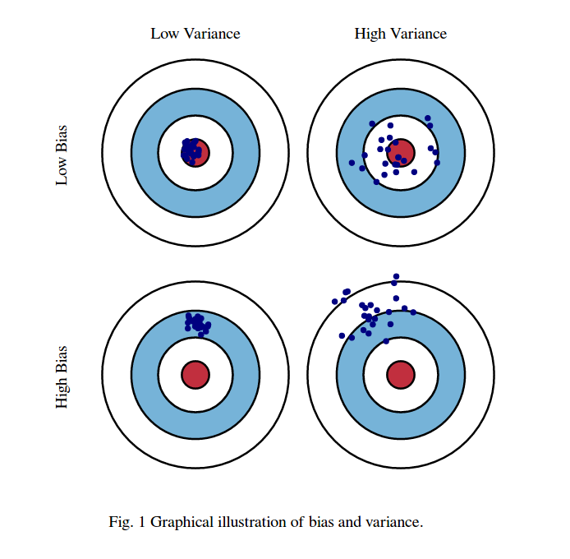
Definitions
Variance – how consistent is my model / sampling
Bias – how close to the truth is my model
Which of these is the enemy?
High variance – we can deal with by sampling more (Monte Carlo) – maybe sampling is cheap, maybe its expensive though (real world environment)
High bias – we can’t correct this = bias is the true enemy
We introduce bias when we start to use bootstrapped function approximations
Notes:
Focus on key concepts – the field goes much deeper
Shouldn’t expect to learn everything
Its ok if you don’t grasp everything!

Slide 10
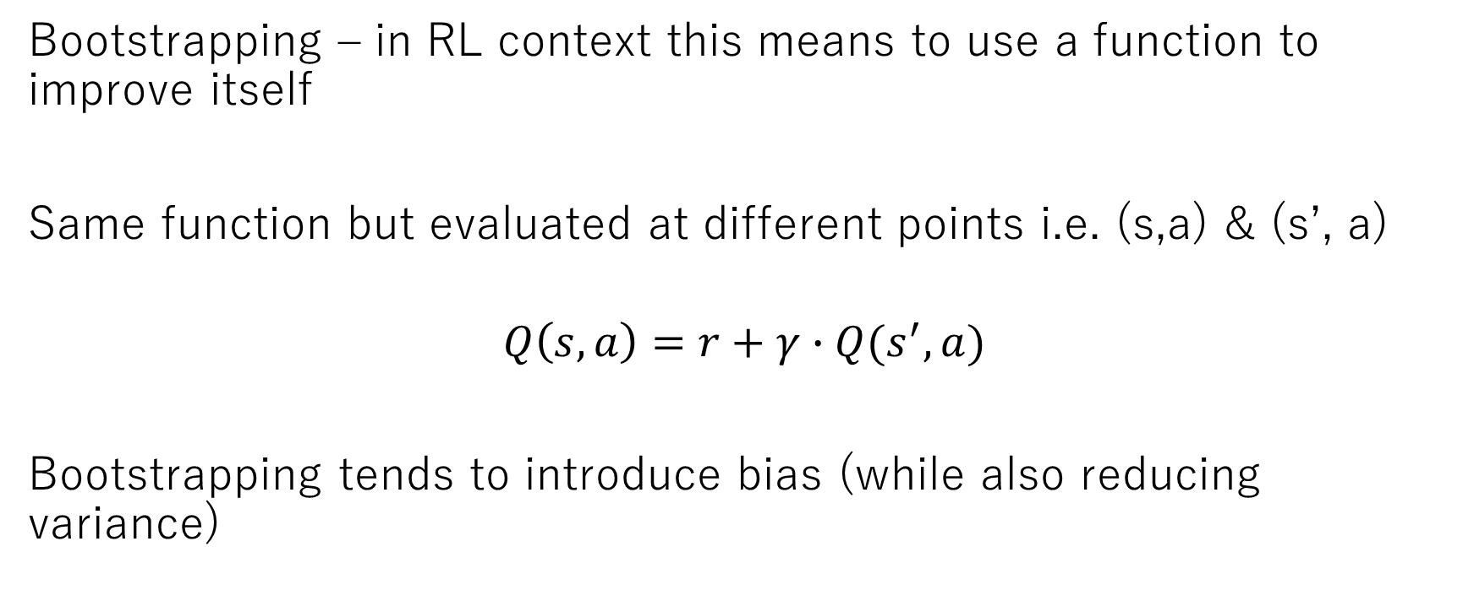
Bootstrapping
Bootstrapping – in RL context this means to use a function to improve itself
Same function but evaluated at different points i.e. (s,a) & (s’, a)
$$Q\left(s,a\right)=r+γ∙Q(s^{′},a)$$
Bootstrapping tends to introduce bias (while also reducing variance)
Notes:
Focus on key concepts – the field goes much deeper
Shouldn’t expect to learn everything
Its ok if you don’t grasp everything!

Slide 11
Part One Introduction to reinforcement learning

Slide 12
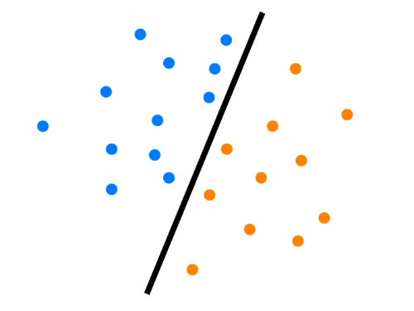
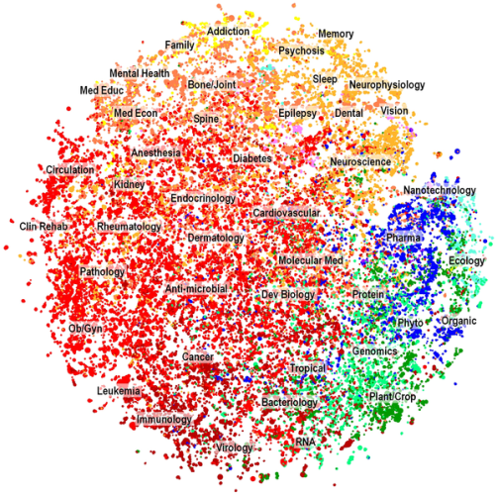

Machine learning
Supervised
Unsupervised
Reinforcement
learning known patterns
learning unknown patterns
taking actions
generating data
learning patterns
Notes:
Machine learning is learning patterns in data (all machine learning is about learning patterns).
Three broad categories, depending on the nature of the learning "signal" or "feedback" available to a learning system.
Vast majority of ML value currently driven by supervised learning.
We use supervised learning techniques in reinforcement learning.

Slide 13
Reinforcement learning
Value function methods
Parameterize a value function
V(s, θ)
Q(s, a, θ)
Policy methods
Parameterize a policy
π(s, θ)
Actor-critic
Parameterize a value function and policy

Slide 14
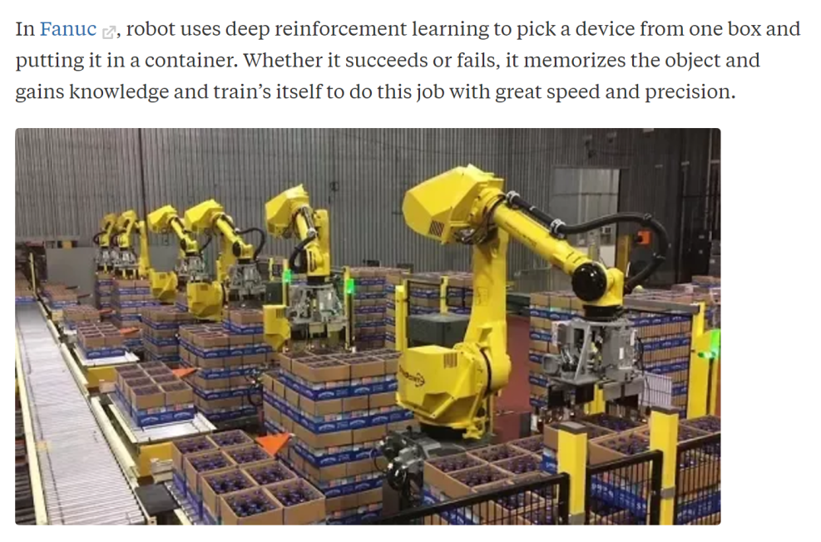
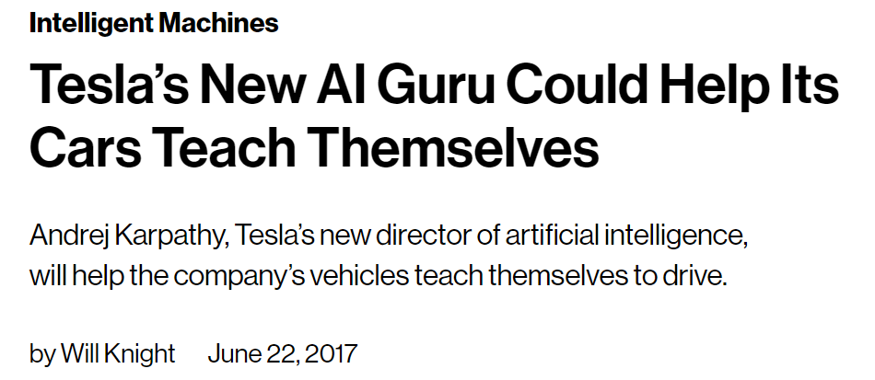
Applications
Robotics Self driving cars
Smart contracts on blockchains, inventory & delivery management, recommendation systems, neural network design...

Slide 15
Reinforcement learning is not
RL is NOT an alternative method to used instead of a random forest, neural network
“I’ll try to solve this problem using a convolutional nn or RL” nonsensical
Neural networks are a tool that both supervised and reinforcement learners use

Slide 16
Reinforcement learning
is
learning through action

Slide 17
Learning – by interacting
vs.
Planning – by simulation
Notes:
Learning = actual experience
Planning = simulated experience from a model of environment

Slide 18
Prediction – what's going to happen
vs.
Control – what's the best thing that could happen

Slide 19
Exploration – finding information
vs.
Exploitation – using information

Slide 20
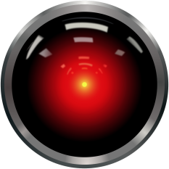
learns to maximise reward
Agent
state,
reward
data
action
what to do
Environment
responds to action
Notes:
Formulating energy system as a RL problem

Slide 21
Why reinforcement learning is different
Reinforcement learning is both generating a data set then learning patterns from it
Data generated by the learner
start out with no data
data set = [state, action, reward, next state]
dataset is correlated (state sequences)
learning changes behaviour distribution
Input to the agent depends on previous actions

Slide 22
Why reinforcement learning is different
Delayed & sparse reward signal
‘Credit assignment’ problem
Exploration/exploitation dilemma
Time really matters
Not obvious what to approximate
What should we actually learn?

Slide 23
Why reinforcement learning is different
Supervised learning = only as good as the dataset
RL = can learn through self play to go beyond humans
Reinforcement learning is hard
techniques are not well established
Deep RL = won’t work out of the box
lots of knobs to tune
Lose convergence guarantees when you use non-linear function approximators

Slide 24
Markov Decision Processes

Slide 25
Markov Decision Processes (MDP)
Mathematical framework for modelling decision making in a given environment
Framework for the reinforcement learning problem
Episodic vs non-episodic (episode length & termination)
Observable vs hidden (true state visibility to agent)
Continuous vs discrete (state / action spaces)

Slide 26
Formal definition
Set of states S [s₁, s₂ ...]
Set of actions A [a₁, a₂ ...]
Transition function P(s’|s, a)
probability of going to next state s’ from state s after taking action a
Reward function R(s, a, s’)
Reward after taking action a in state s, ending up in next state s’
Discount factor γ, Horizion H

Slide 27
Informal definition
Two objects
agent + environment
Three signals
state, action, reward

Slide 28
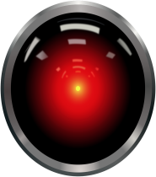



two objects
three signals
Agent
state,
reward
action
Environment

Slide 29
past is irrelevant given the present
Markov State
=
state that fully represents history

Slide 30
also possible to have ‘partially observable’ MDPs
Markov Decision Process (MDP)
=
directly observe full environment state,
includes rewards & decisions

Slide 31
Environment
AGENT
Real or virtual
Discrete vs. continuous
Action space
State space
Episodic vs. non-episodic
policy
value functions
env. models
action
ENVIRONMENT
state,
reward

Slide 32
State (s, s’)
Flexible concept
n-d array per time step
Help the agent learn & choose next action
Fully observed vs. hidden
AGENT
policy
value functions
env. models
action
ENVIRONMENT
state,
reward

Slide 33
Reward (r)
AGENT
Flexible concept
Scalar per step
Delayed
Sparse
policy
value functions
env. models
action
ENVIRONMENT
state,
reward
Notes:
Instantaneous – but maybe only because of an action taken a long time ago!
Delayed
Supervised = direct association
Reinforcement = delayed
Sparse
Supervised = lots of data
Reinforcement = sparse signal

Slide 34
Action (a)
AGENT
Environment dependent
Discrete vs. continuous
Variable vs. constant action space
policy
value functions
env. models
action
ENVIRONMENT
state,
reward
Notes:
Instantaneous – but maybe only because of an action taken a long time ago!
Delayed
Supervised = direct association
Reinforcement = delayed
Sparse
Supervised = lots of data
Reinforcement = sparse signal

Slide 35
Agent
AGENT
Agent = learner and decision maker
goal to maximise cumulative reward
Agent can use
explicit policy
value function
predictive model of environment
policy
value functions
env. models
action
ENVIRONMENT
state,
reward
Notes:
Predictive model of environment (ie of next state or next reward)

Slide 36
Agent - Policy (π)
AGENT
Policy = rules to select actions
def policy(state): return action
action = policy(state)
Agent always follows a policy
act randomly
always pick action a₂
act optimally – maximize future reward
Deterministic or stochastic
Stochastic = conditional probability distribution across actions
policy
value functions
env. models
action
ENVIRONMENT
state,
reward

Slide 37
Agent - Policy (π)
AGENT
action
On vs. off policy
On policy learning = can only learn
about the policy that I’m following now
Off policy learning = can learn about
other policies
Policy can be
Generated from a value function = value function methods (Part Two)
Parameterized directly = policy methods (Part Three)
policy
value functions
env. models
ENVIRONMENT
state,
reward

Slide 38
Agent – Environment model
Env model = predict environment response to actions
predicts next state, reward (from state s)
used for planning (rather than learning)
Sample vs. distribution model
i.e. – rolling dice
Model vs. model free algorithms
model = optional
AGENT
policy
value functions
env. models
action
ENVIRONMENT
state,
reward
Notes:
Simulated versus real experience
If we have a model, we can make double use of our data – one to improve model, other to improve policy/value function
Can be a lot easier to produce a sample (than to program the entire distribution)
If we have distribution, we can eaisly produce samples

Slide 39
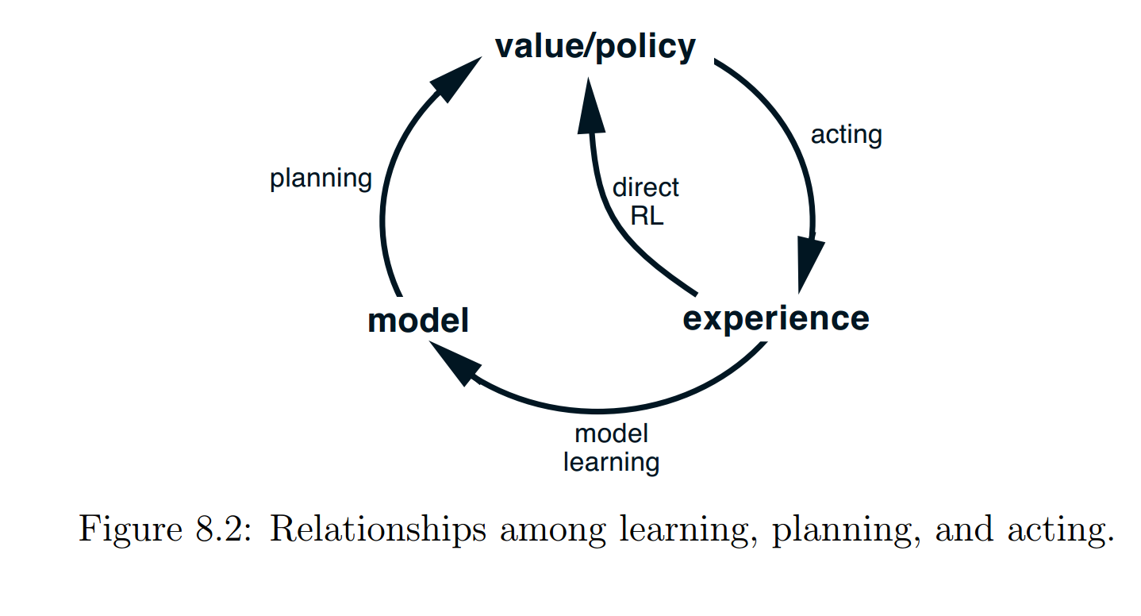
Learning, planning & acting

Slide 40
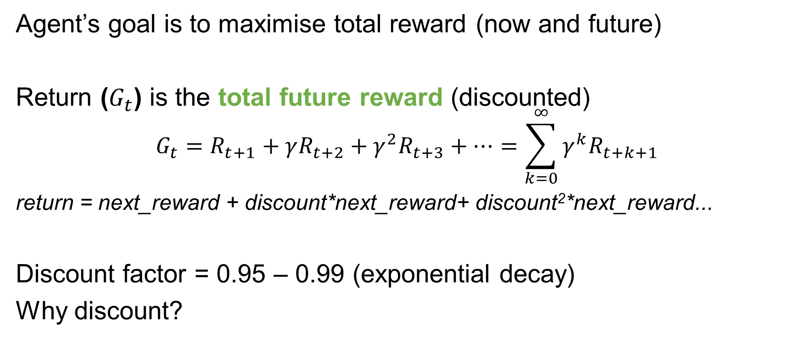
Return
Agent’s goal is to maximise total reward (now and future)
Return ($G_{t}$) is the total future reward (discounted)
$$G_{t}=R_{t+1}+γR_{t+2}+{γ^{2}R}_{t+3}+…=\sum_{k=0}^{∞}{γ^{k}R_{t+k+1}}$$
return = next_reward + discount*next_reward+ discount²*next_reward...
Discount factor = 0.95 – 0.99 (exponential decay)
Why discount?
Notes:
y=1=farsighted
y=0=near sighted
Hyperbolic discounting refers to the tendency for people to increasingly choose a smaller-sooner reward over a larger-later reward as the delay occurs sooner rather than later in time.
Time value of money – EUR 1000 is more valuable today than EUR 1000 in 1 years time

Slide 41
Discounting
Future is uncertain
value getting reward sooner as environment might be stochastic
Matches how humans think
Hyperbolic discounting
Finance
Time value of money
Notes:
y=1= farsighted
y=0= near sighted
Hyperbolic discounting refers to the tendency for people to increasingly choose a smaller-sooner reward over a larger-later reward as the delay occurs sooner rather than later in time.
Time value of money – EUR 1000 is more valuable today than EUR 1000 in 1 years time

Slide 42
Exploration vs. exploitation
Do I go to the restaurant in Berlin I think is best, or should I try something new?
Design of reward signal vs. amount of exploration required
Algorithm does care about the time step
too small = rewards are delayed (credit assignment harder)
exploration becomes more like a random walk

Slide 43
A new level of intelligence
Artificial Intelligence and the Future | Demis Hassabis (2016)
https://www.youtube.com/watch?v=i3lEG6aRGm8&#t=27m12s
Demis Hassabis is Founder & CEO of DeepMind
Talking about the brilliance of AlphaGo in it’s 2015 series
Monte Carlo Tree Search
Policy approximation
Value function approximation
Creativity of machines

Slide 44
Break
Notes:
y=1= farsighted
y=0= near sighted
Hyperbolic discounting refers to the tendency for people to increasingly choose a smaller-sooner reward over a larger-later reward as the delay occurs sooner rather than later in time.
Time value of money – EUR 1000 is more valuable today than EUR 1000 in 1 years time

Slide 45
Recap
Two objects – three signals
Agent & environment. State, reward, action
Policy = rules to select actions
Environment model = predict next state, reward
Return = total discounted reward
Credit assignment problem
Exploration vs exploitation
Notes:
y=1= farsighted
y=0= near sighted
Hyperbolic discounting refers to the tendency for people to increasingly choose a smaller-sooner reward over a larger-later reward as the delay occurs sooner rather than later in time.
Time value of money – EUR 1000 is more valuable today than EUR 1000 in 1 years time

Slide 46
Reinforcement learning
Google DeepMind's Deep Q-learning playing Atari Breakout
https://www.youtube.com/watch?v=V1eYniJ0Rnk
Q-Learning
Creativity – agent found a policy that the programmers didn’t know about
Notes:
Focus on key concepts – the field goes much deeper
Shouldn’t expect to learn everything
Its ok if you don’t grasp everything!

Slide 47
Part Two Value function methods

Slide 48
Value function methods
Google DeepMind's Deep Q-learning playing Atari Breakout
https://www.youtube.com/watch?v=V1eYniJ0Rnk
Q-Learning
Creativity – agent found a policy that the programmers didn’t know about
Notes:
Focus on key concepts – the field goes much deeper
Shouldn’t expect to learn everything
Its ok if you don’t grasp everything!

Slide 49
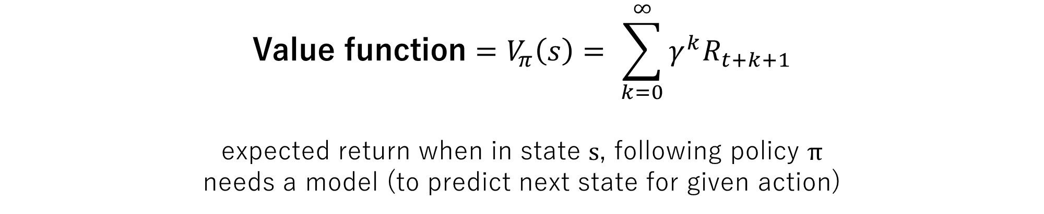
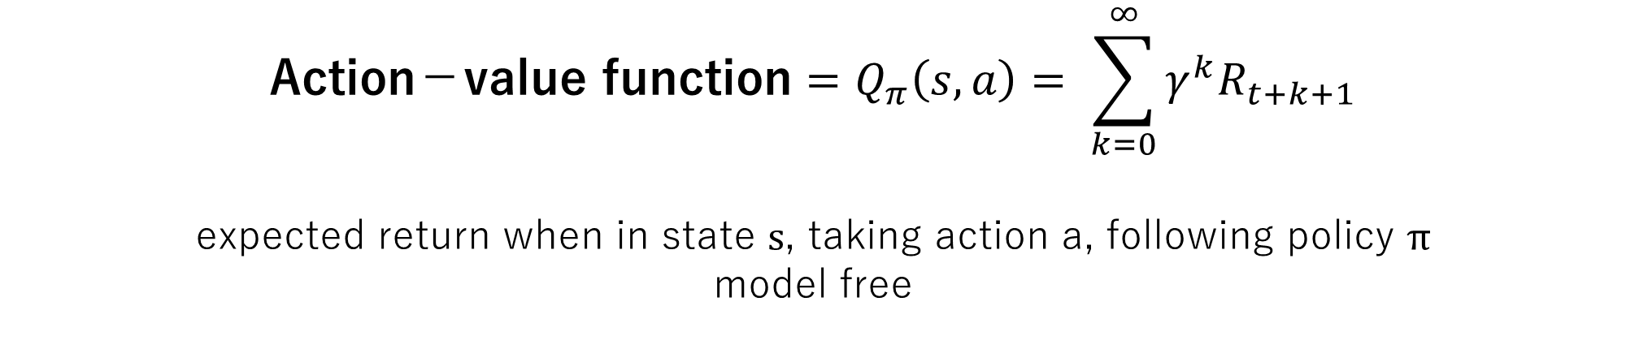
Value functions
$$\text{Value} \text{function}=V_{π}\left(s\right)= \sum_{k=0}^{∞}{γ^{k}R_{t+k+1}}$$
expected return when in state s, following policy π
needs a model (to predict next state for given action)
$$\text{Action}\text{−}\text{value} \text{function}=Q_{π}\left(s,a\right)= \sum_{k=0}^{∞}{γ^{k}R_{t+k+1}}$$
expected return when in state s, taking action a, following policy π
model free
Notes:
This is what we are trying to learn
If we had the optimal value function – we could choose optimal next states / actions
WE learn Q because it allows us to be model free (if we learn V we still need to know the probabilities of transitioning to different states)

Slide 50

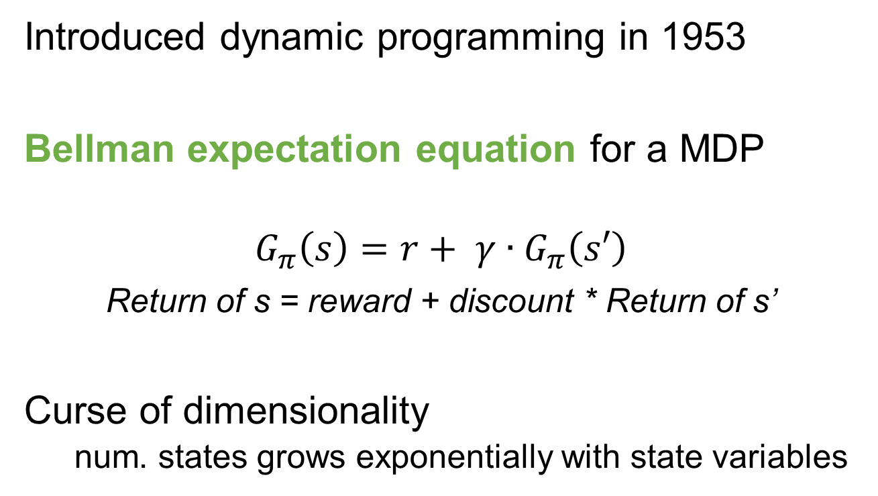
Bellman
Introduced dynamic programming in 1953
Bellman expectation equation for a MDP
$$G_{π}\left(s\right)=r+ γ∙G_{π}\left(s′\right)$$
Return of s = reward + discount * Return of s’
Curse of dimensionality
num. states grows exponentially with state variables

Slide 51
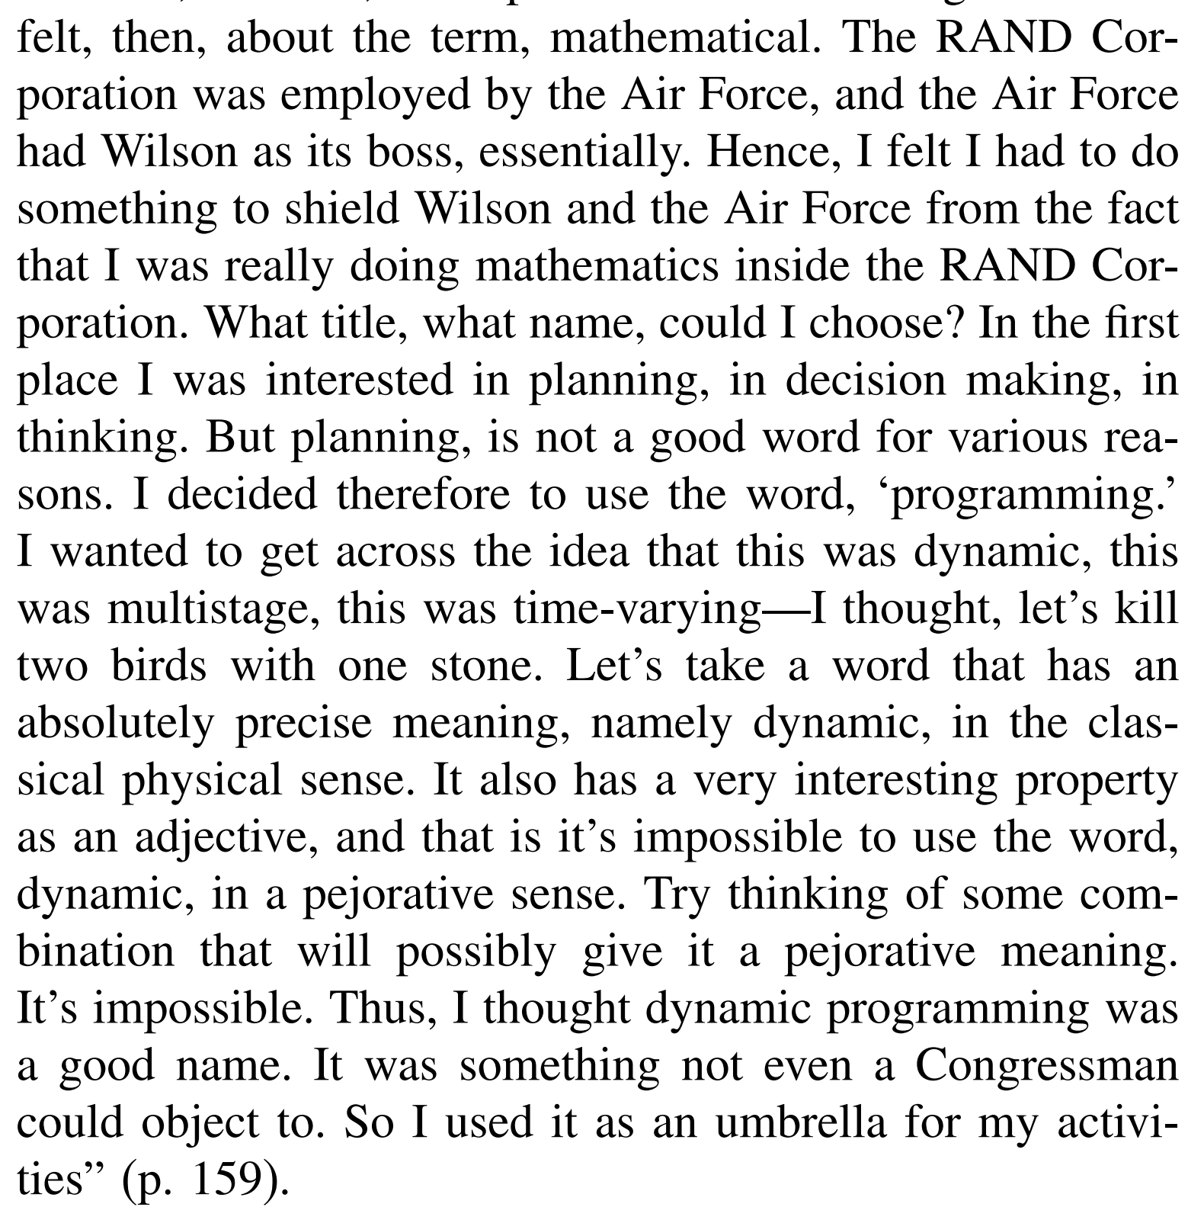
Why dynamic programming?
http://www.cas.mcmaster.ca/~se3c03/journal_papers/dy_birth.pdf

Slide 52

What happens if we combine a value function with the Bellman equation
$$\text{Value} \text{function}=V_{π}\left(s\right)= \sum_{k=0}^{∞}{γ^{k}R_{t+k+1}}$$
+
$$\text{Bellman} \text{equation}=V_{π}\left(s\right)=r+ γ∙V_{π}\left(s′\right)$$

Slide 53
recursive relationship between states
value of being here
v(s)
=
r
reward we get
+
v(s’)
value of next state
s
state
r
s’
next state
Notes:
We don’t have it yet
All we have is a blank lookup table or NN with random weights

Slide 54
How does a value function
help us to act?
Notes:
Learning = actual experience
Planning = simulated experience from a model of environment

Slide 55
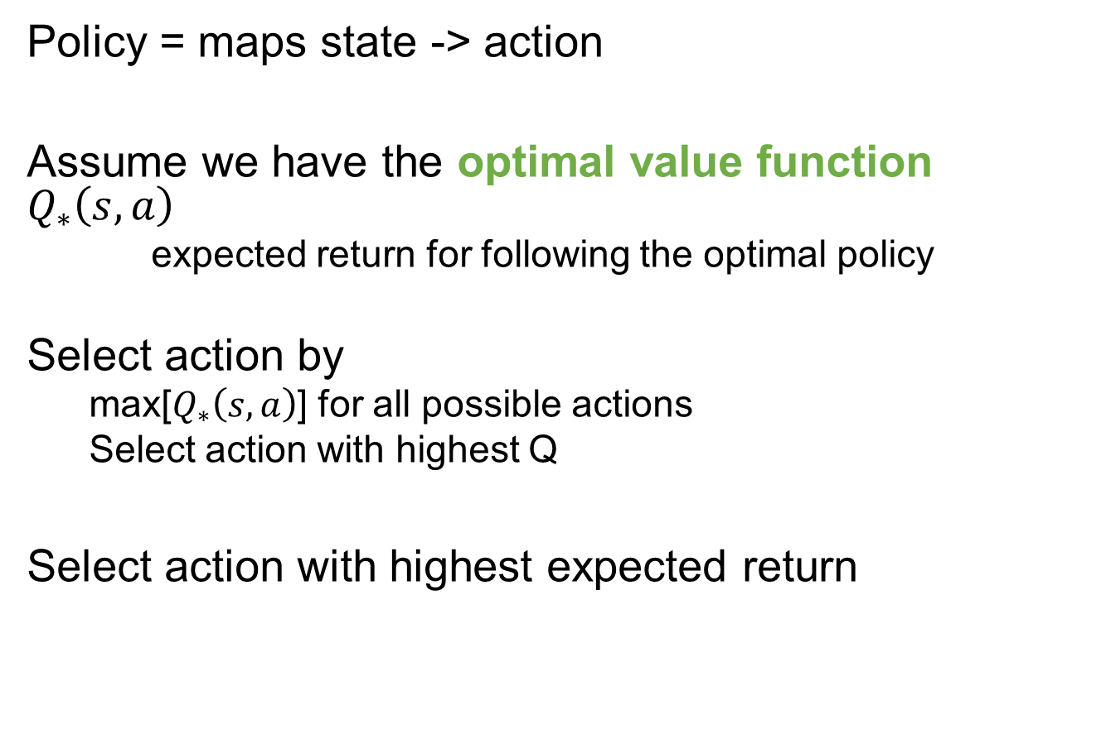
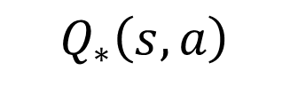
Generating the optimal policy
s
Policy = maps state -> action
Assume we have the optimal value function $Q_{∗}\left(s,a\right)$
expected return for following the optimal policy
Select action by
max[$Q_{∗}\left(s,a\right)$] for all possible actions
Select action with highest Q
Select action with highest expected return
a₁
a₂
a₃
$$Q_{∗}\left(s,a\right)$$
3
4
5

Slide 56
Optimal policy = acting greedily according to optimal value function
policy is generated
from the value function
Notes:
Learning = actual experience
Planning = simulated experience from a model of environment

Slide 57
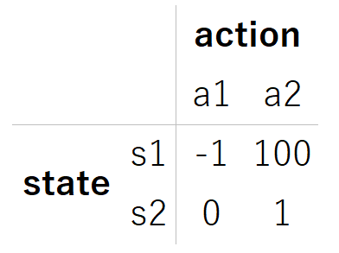
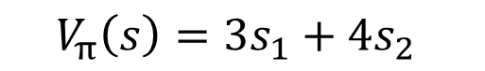
Parameterizing value functions
lookup table
curse of dimensionality
linear function
less parameters
generalize across states
non-linear function
model complex dynamics
vision tasks
lose convergence guarantee
$$V_{π}\left(s\right)={3s}_{1}+{4s}_{2}$$
s
Q
a
Notes:
Lookup table is a special case of the linear function
Advantage of using function over lookup table:
we can represent a lot more information with less parameters
also allows us to estimate the value for states we haven’t visited before

Slide 58
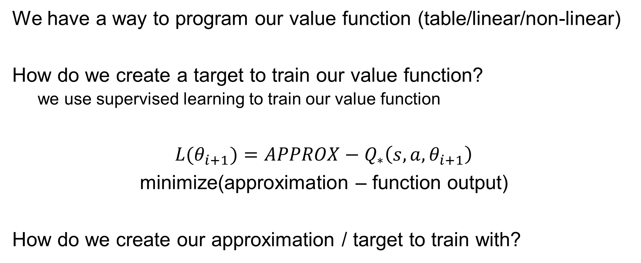
Value function improvement
We have a way to program our value function (table/linear/non-linear)
How do we create a target to train our value function?
we use supervised learning to train our value function
$L(θ_{i+1})=$ $APPROX−Q_{∗}\left(s,a, θ_{i+1}\right)$
minimize(approximation – function output)
How do we create our approximation / target to train with?

Slide 59
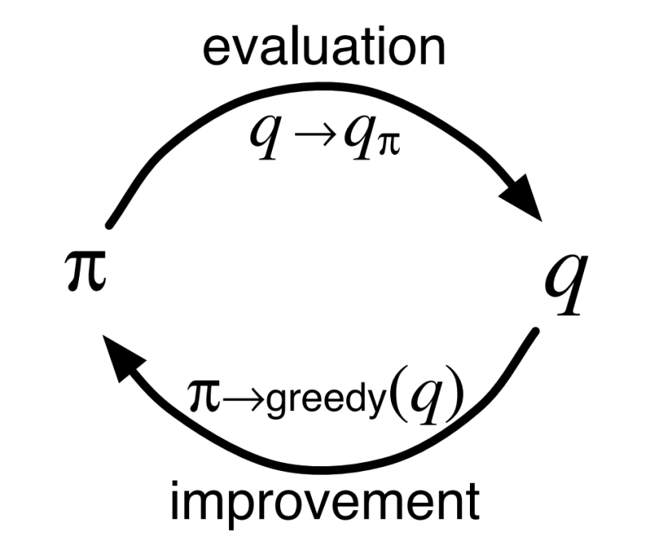
Value function approximation
Dynamic Programming / Monte Carlo / Temporal Difference
Different methods for solving the approximation/evaluation problem
Method for solving the improvement
problem is the same for each
change policy to favour best action

Slide 60
Dynamic Programming
Imagine you had a perfect environment model
model of state transition probabilities and rewards
How would you use a perfect environment model to estimate a value function
s₁
s₂
s₃
s₄
s₅
Notes:
Full or asynchronous backups

Slide 61
V(s₁) = value fctn of state 1
p = probability
p₃₄ = probability of moving from state 3 to 4
r = reward
p₃₄ = reward moving from state 3 to 4
first state
s₁
p = 50%
r = 2
p = 50%
r = 1
s₂
s₃
Use the bellman equation:
V(s) = r + v(s’)
V(s₄), V(s₅) = 0
V(s₃) = p₃₄(r₃₄ +V(s₄)) + p₃₅(r₃₅ +V(s₅))
V(s₁) = p₁₂(r₁₂ +V(s₂)) + p₁₃(r₁₃ +V(s₃))
p = 10%
r = 1
p = 90%
r = 1
s₄
s₅
back values
upwards
(backup)

Slide 62
Dynamic Programming
Requires a perfect environment model
model of state transition probabilities and rewards
Bootstrapped
value function improves itself
Reliable convergence (finite, fully observed MDP)
Computationally expensive
backup value of each state
Notes:
Full or asynchronous backups

Slide 63
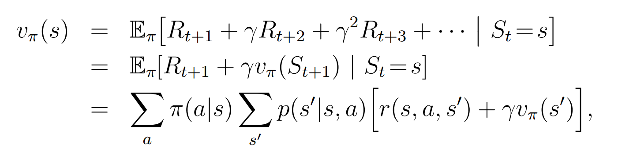
Dynamic Programming
Value of state s depends on
our policy (what actions we are likely to pick)
the environment dynamics (s,a -> r,s’)
our estimate of the value of s & s’
Value of state s
POLICY
MODEL
BOOTSTRAPPED ESTIMATE

Slide 64

General policy iteration
Allows us to handle non-stationary nature of RL
Non-stationary environment = data distribution will always be changing
Stationary environment, data distribution changes as we learn!
Formed of two distinct steps
1 – policy evaluation / approximation
2 – policy improvement

Slide 65
Policy approximation
=
what is the current value of a state

Slide 66
GPI Step 1 - Policy evaluation
1 – policy evaluation / approximation / estimation
what is the value of state s for current policy
New estimate of v(s)
State transition probabilities
(env model)
estimate of v(s)
from r & v(s’)

Slide 67
Policy improvement
=
what is the maximum value of a state

Slide 68
GPI Step 2 – Policy improvement
2 – policy improvement
Changing our policy to favour best action
New policy
Maximum across all possible actions
(greedy)
State transition probabilities
(env model)
estimate of v(s)
from r & v(s’)

Slide 69
Break
Notes:
y=1= farsighted
y=0= near sighted
Hyperbolic discounting refers to the tendency for people to increasingly choose a smaller-sooner reward over a larger-later reward as the delay occurs sooner rather than later in time.
Time value of money – EUR 1000 is more valuable today than EUR 1000 in 1 years time

Slide 70
Recap
Value function = sum of expected future rewards
Bellman equation
Generating a policy from a value function
Parameterizing value functions
Dynamic programming = model, boostrap
General Policy Iteration
Policy approximation
Policy improvement
Notes:
y=1= farsighted
y=0= near sighted
Hyperbolic discounting refers to the tendency for people to increasingly choose a smaller-sooner reward over a larger-later reward as the delay occurs sooner rather than later in time.
Time value of money – EUR 1000 is more valuable today than EUR 1000 in 1 years time

Slide 71
Monte Carlo
No model required - learns from experience
experience = sample sequences of states, actions & rewards
No bootstrapping - learn from actual return experienced
Average of complete return to estimate v(s)
Value estimates updated at end of episode
works for episodic problems only
no learning within episode
Notes:
No bootstrapping = less harmed by MDP violations
Disadvantage of not being able to update online

Slide 72
Monte Carlo
Estimate value of state by averaging returns observed after visit to that state
we don’t know actual expected value, we estimate by sampling observed returns
As more episodes run, estimate should converge to the expected value (the expected return of state s following policy π)
Low bias & high variance

Slide 73
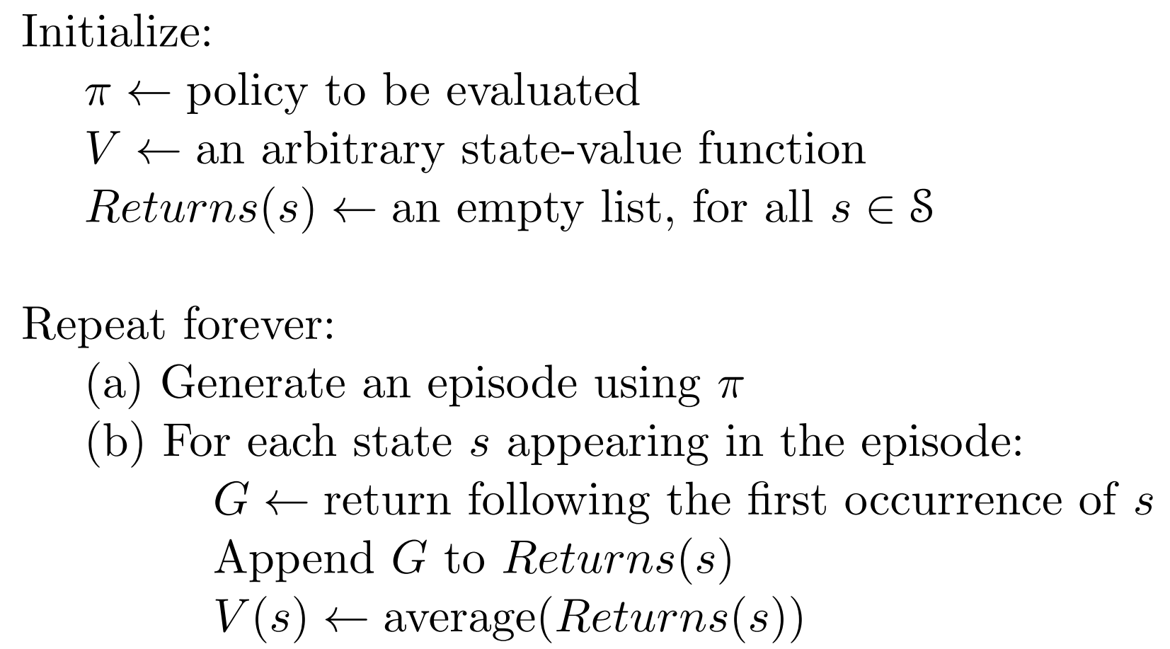
Monte Carlo
i.e. greedy policy
(lookup table)

Slide 74
Monte Carlo
Expense of estimating the value of state s is independent of the number of states
Can focus attention on states of interest
Monte Carlo can be valuable when you only need the value of a subset of states

Slide 75
Temporal Difference
No model required - learns from experience
Bootstrap – learn online
Can do non-episodic problems
Usually faster than Monte Carlo

Slide 76
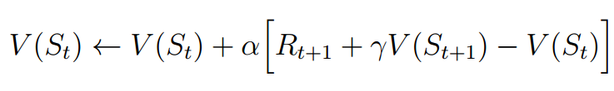
Temporal Difference
We make two estimates in TD
1 - Use our estimate of v(s’) (like DP)
2 – Sample (from experience) used instead of expected v(s) (like MC)
TD(0)
Update sample of (s, s’) experienced
TD error

Slide 77
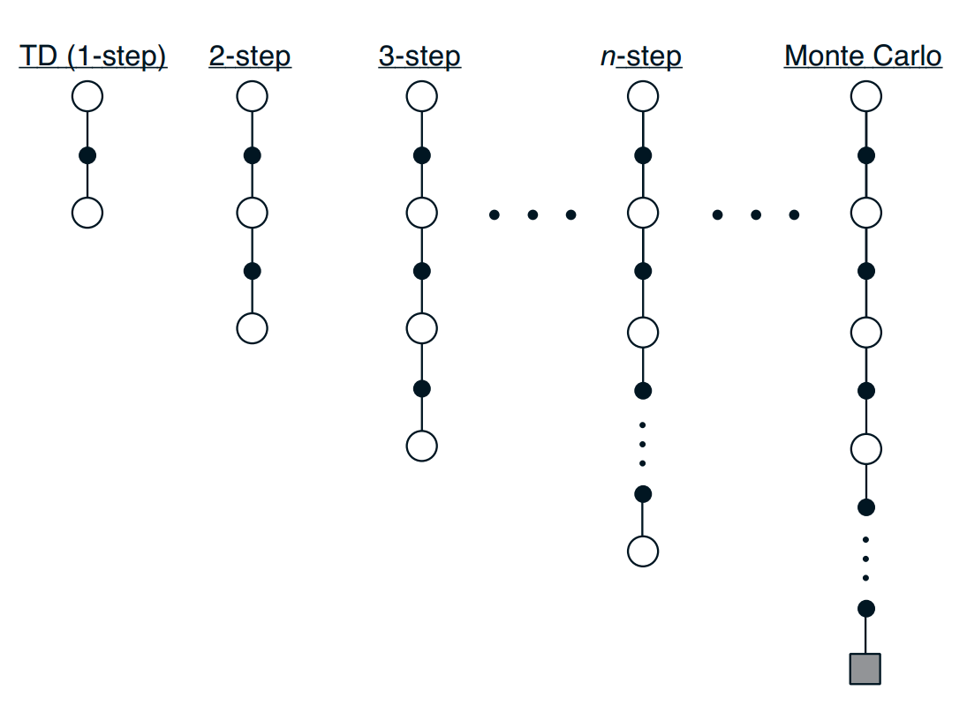
Linking together
TD & MC exist on the same scale
Allows you to trade bias/variance
Further reading
TD(λ)
Eligibility traces
Notes:
y=1= farsighted
y=0= near sighted
Hyperbolic discounting refers to the tendency for people to increasingly choose a smaller-sooner reward over a larger-later reward as the delay occurs sooner rather than later in time.
Time value of money – EUR 1000 is more valuable today than EUR 1000 in 1 years time

Slide 78
TD(λ)
Notes:
y=1= farsighted
y=0= near sighted
Hyperbolic discounting refers to the tendency for people to increasingly choose a smaller-sooner reward over a larger-later reward as the delay occurs sooner rather than later in time.
Time value of money – EUR 1000 is more valuable today than EUR 1000 in 1 years time

Slide 79
Break
Notes:
y=1= farsighted
y=0= near sighted
Hyperbolic discounting refers to the tendency for people to increasingly choose a smaller-sooner reward over a larger-later reward as the delay occurs sooner rather than later in time.
Time value of money – EUR 1000 is more valuable today than EUR 1000 in 1 years time

Slide 80
Recap - value function approximation
Dynamic programming – model based, planning, estimates based on complete distribution of state transitions & estimated returns
Monte Carlo – model free, needs episodes terminating, estimates based on sample of observed state transitions & true returns
Temporal difference – model free, bootstrap, estimates based on sample of observed transitions & estimated returns

Slide 81
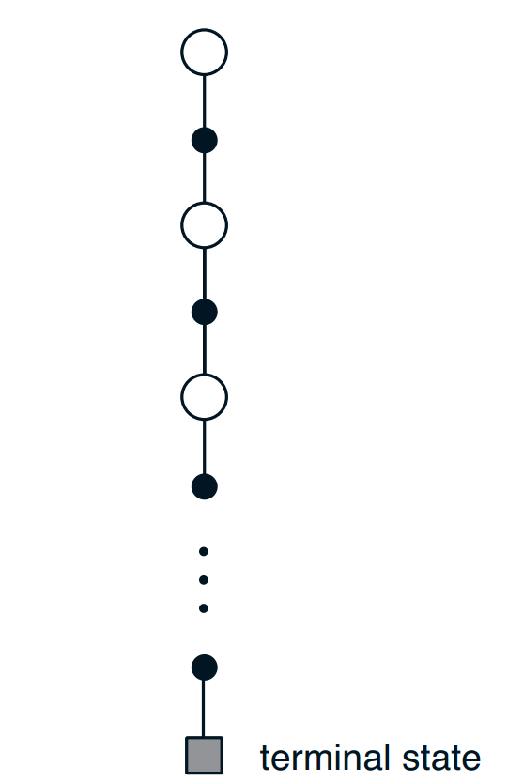
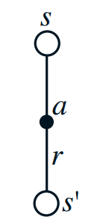
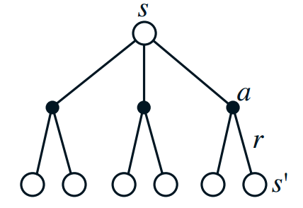
Recap - value function approximation
Dynamic
Programming
Monte Carlo
Temporal Difference

Slide 82
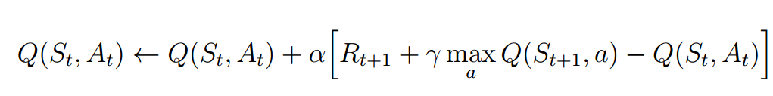
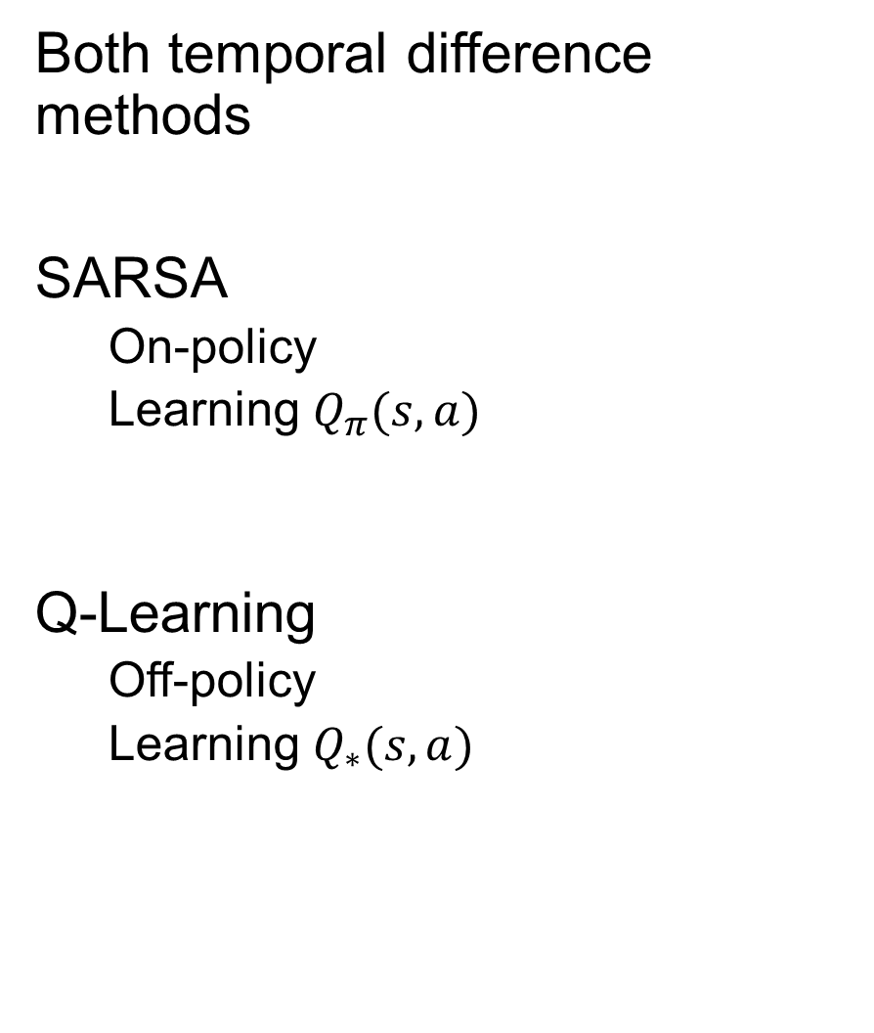
SARSA & Q-Learning
Both temporal difference methods
SARSA
On-policy
Learning $Q_{π}(s,a)$
Q-Learning
Off-policy
Learning $Q_{∗}(s,a)$
Here we take our Q estimate for observed s’, a’
Here we take the max Q for our observed s’,

Slide 83
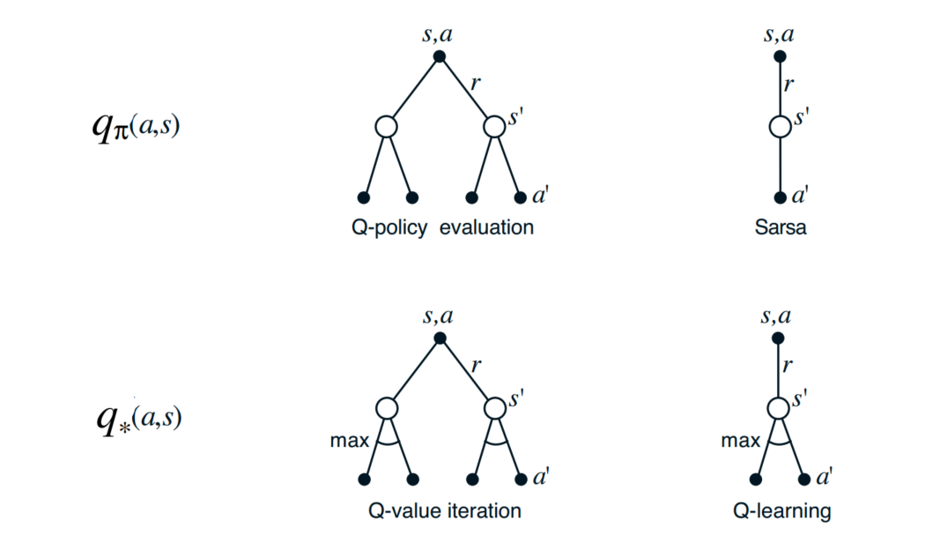
SARSA & Q-Learning
On policy
Policy evaluation
Off policy
Policy improvement

Slide 84
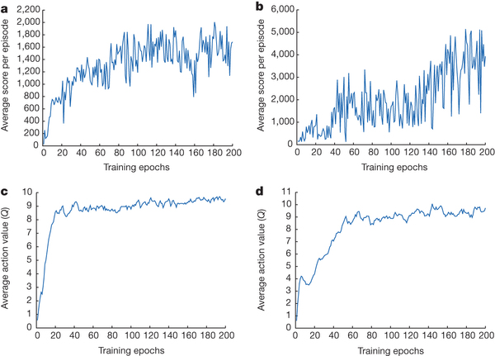
Minh et. Al (2015) - Human-level control through deep reinforcement learning
https://www.nature.com/nature/journal/v518/n7540/full/nature14236.html

Slide 85
Maximization Bias
Consider state with true value Q(s,a) = 0 (for all a)
Our estimates are distributed above & below 0
Max(true values) = 0
Max(estimated values) > 0 = a positive bias
Use of the maximum is aggressive

Slide 86
Double Q-Learning
Removes bias – specifically maximization bias
Maintain two value functions (Q1, Q2)
Both functions generate a policy Q(s,a) = avg(Q1, Q2)
Q1 used to create estimate
Q2 trained using estimate (randomly swap Q1 & Q2)

Slide 87
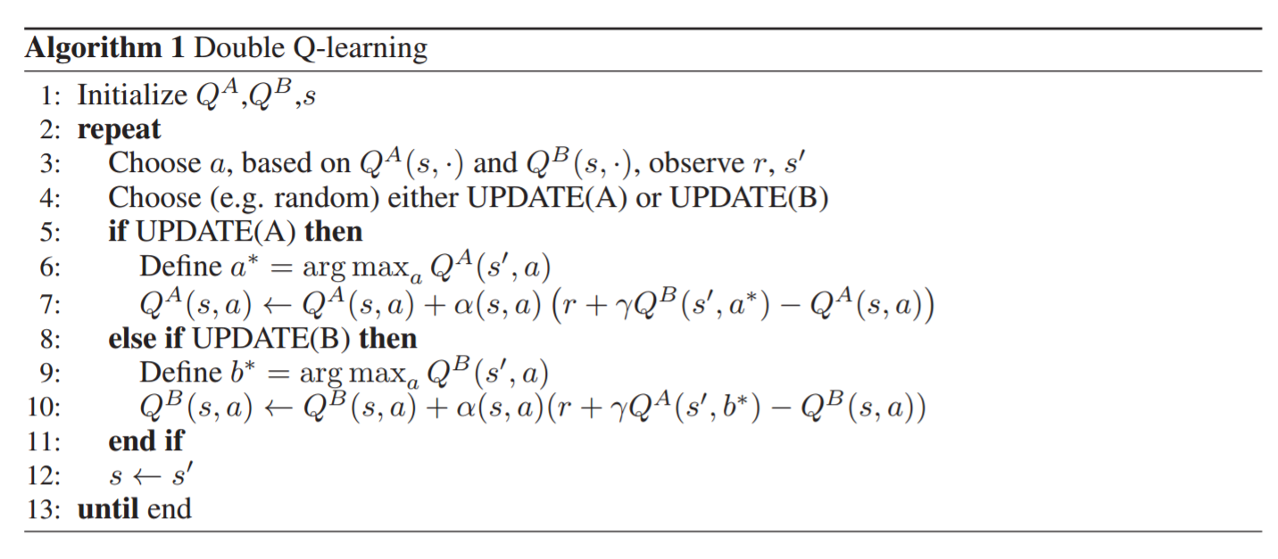
Double Q-Learning
Policy based on both Q
Select a Q to update

Slide 88
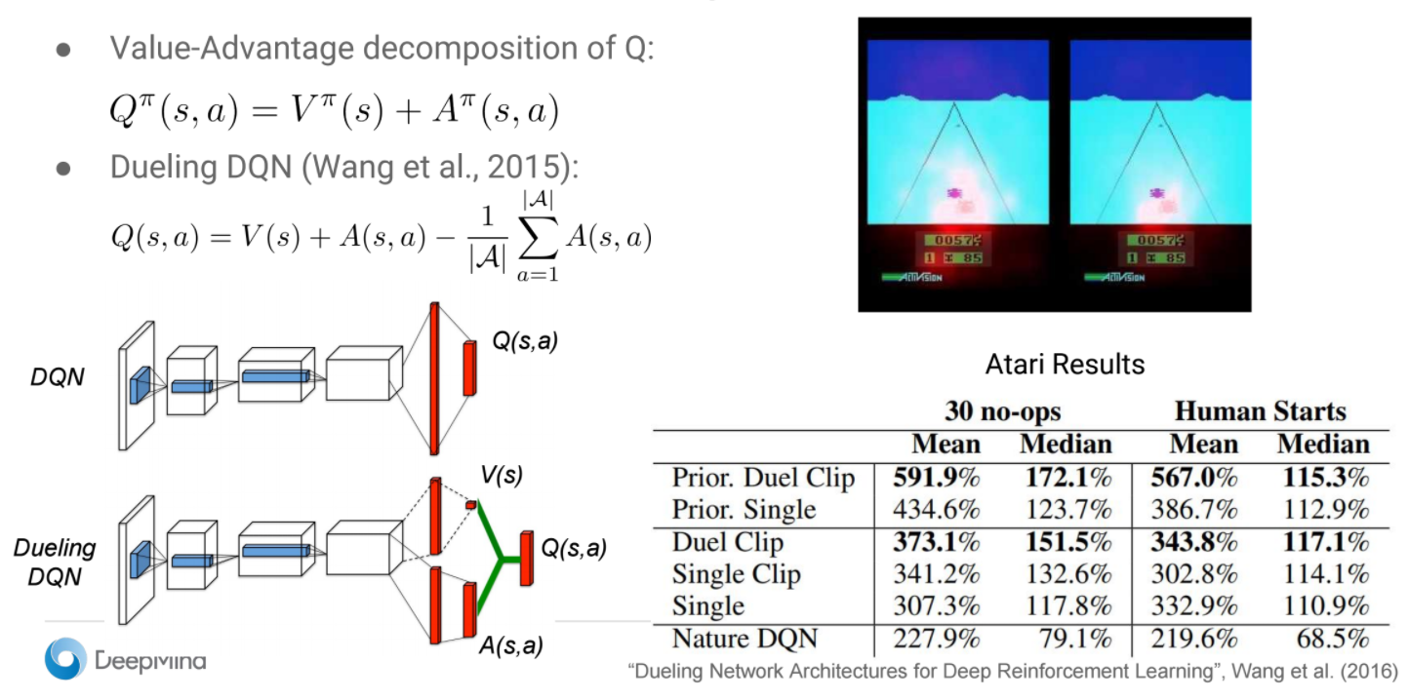

Dueling DQN
Change network structure to predict V(s), A(s,a) and calculate Q(s,a)
Better than just predicting Q(s,a) !
Q(s,a) = V(s) + A(s,a)
Action-value fctn = value fctn + advantage fctn
Vlad Minh – Deep Q-Networks – Deep RL Bootcamp 2017

Slide 89
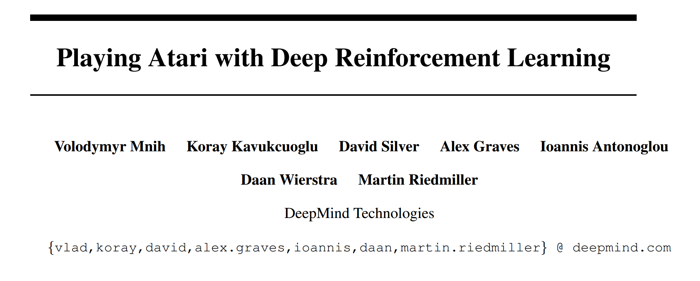
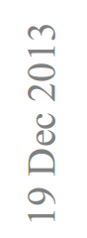
Literature review
Notes:
Bought company with no revenue, no customers, few employees

Slide 90
What makes this paper significant
End to end deep reinforcement learning
state = pixels of last four images
Ability of the algorithm to generalize
identical model structure & parameters* to learn seven different games
First step towards a general artificial intelligence
better than expert performance on three games
* One game required changing one hyperparameter
Notes:
Bought by Google for roughly half a billion dollars – a company with no product, no revenue, no customers and a few employees

Slide 91
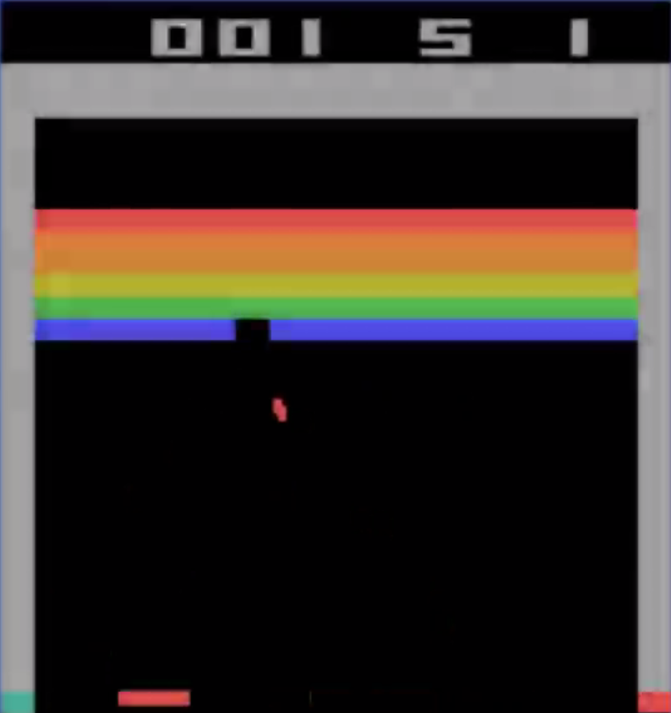

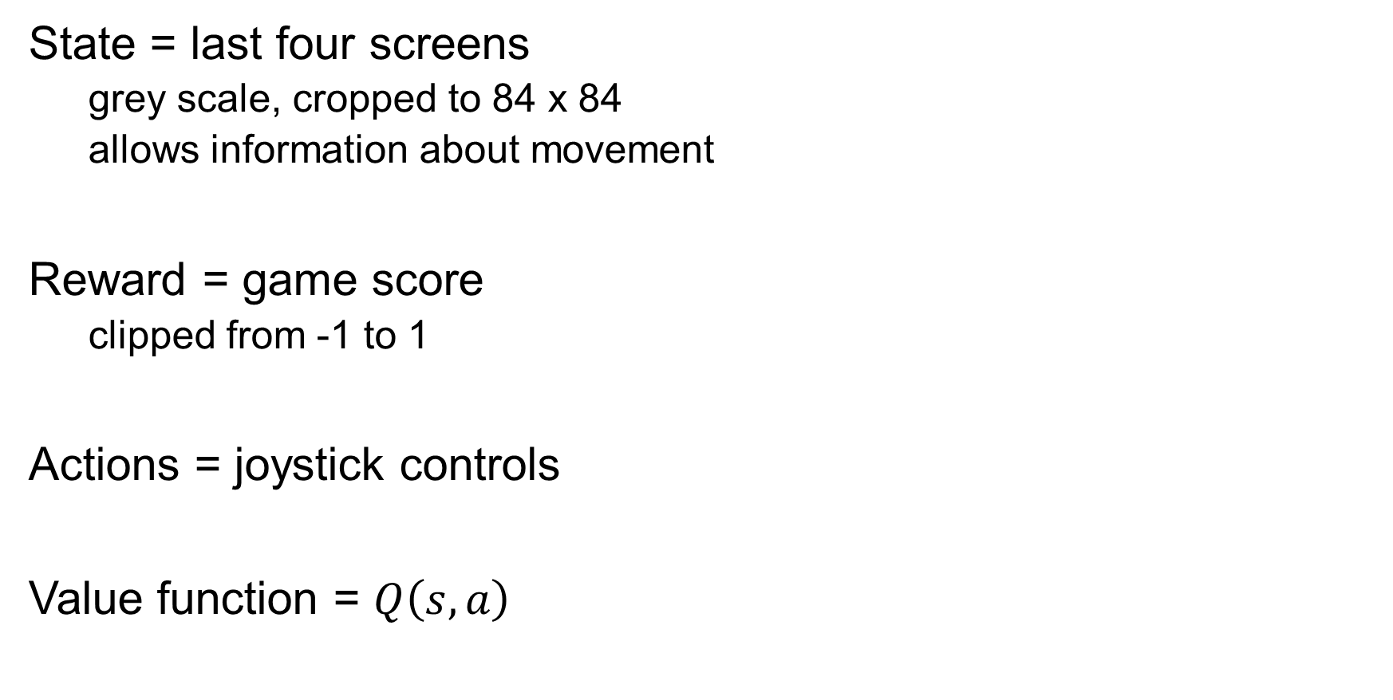
Reinforcement learning to play Atari
State = last four screens
grey scale, cropped to 84 x 84
allows information about movement
Reward = game score
clipped from -1 to 1
Actions = joystick controls
Value function = $Q\left(s,a\right)$
Notes:
What is atair
See the flexible concept of state

Slide 92
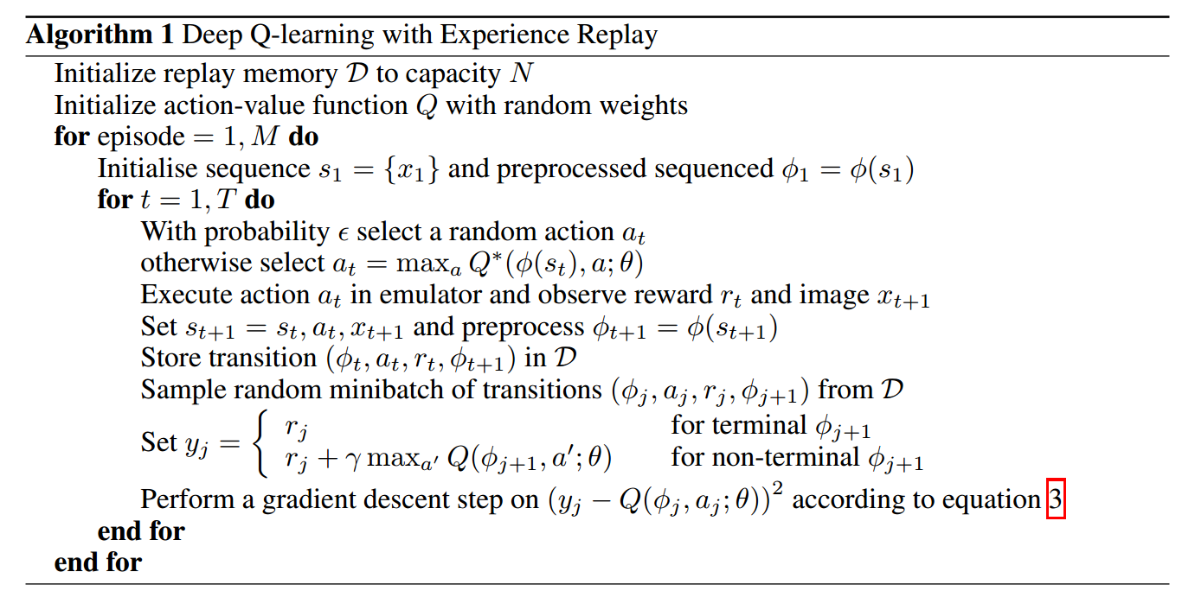
ε-greedy action selection
action-value function target
Training to improve Q

Slide 93
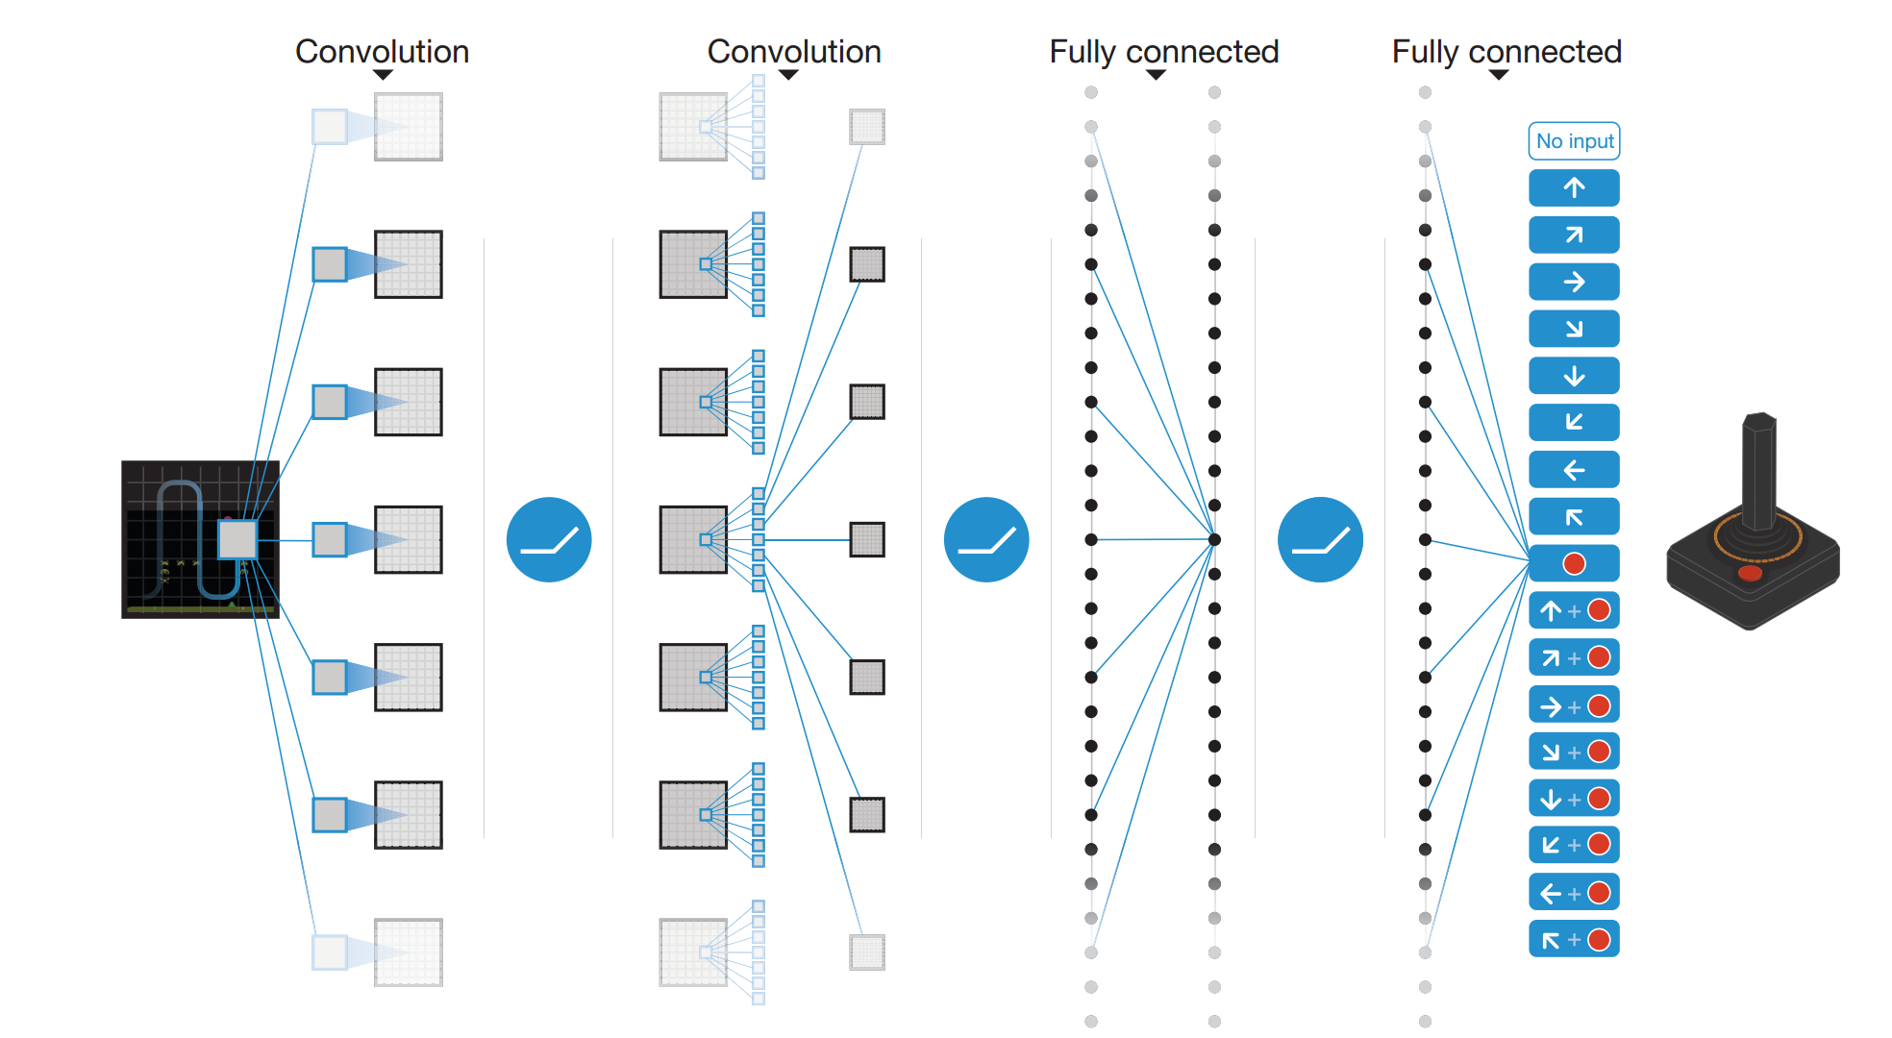
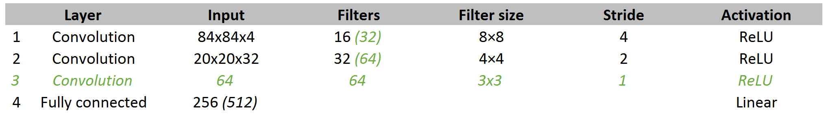
Value function approximation
2013 – Playing Atari with Deep Reinforcement learning
2015 – Human-level control through deep Reinforcement learning
Notes:
NO POOLING LAYERS
pooling gives you translation invariance
this is good for object identification but for games location is relevant so we want to keep this information
Notice the structure of the network – one output node for each action (single pass across network!!!!) – works for constant action space!!!!

Slide 94
Problems with Q-Learning
Mostly to do with stability
Changing the value for one state changes value for other states
Correlation in targets & data
Non-stationary data distribution (supervised techniques assume you are sampling from fixed distribution)

Slide 95
Inspiration
High level idea = make Q-Learning look like supervised learning
Supervised learning assumes that we are sampling from a fixed data distribution
In reinforcement learning our data distribution is not stationary!
Apply two main ideas
1 – experience replay
2 – target network

Slide 96
Methods
Experience replay
memory of last 1 million frames
network trained using batches of 32-64 random samples
averaging of behaviour distribution
data efficiency (reuse experience multiple times)
avoids the correlation of s to s’ (within trajectory)
allows seeding with human expert experience
Target network
Identical Q-network with frozen weights – used to create target
Every t steps (10,000 – 100,000), parameters from main Q copied to target
More stable training
Notes:
Use a separate network to estimate the TD target. This target network has the same architecture as the function approximator but with frozen parameters. Every T steps (a hyperparameter) the parameters from the Q network are copied to the target network. This leads to more stable training because it keeps the target function fixed (for a while).

Slide 97
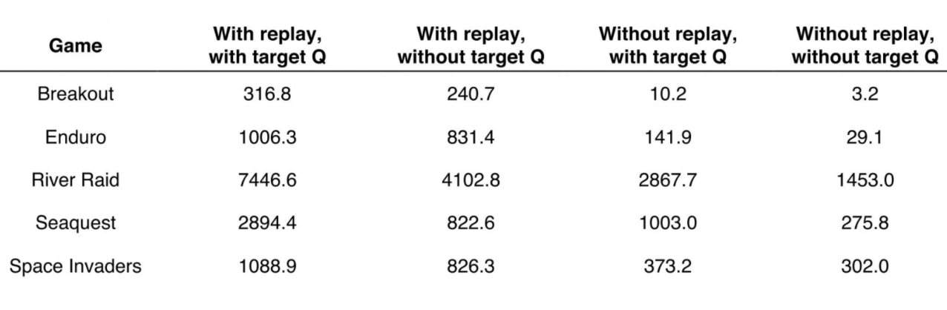
Stability techniques
100x
1000x
5x
10x
3x
Vlad Minh – Deep Q-Networks – Deep RL Bootcamp 2017

Slide 98
Methods
Reward clipping
fix all positive rewards to 1, all negative to -1
essentially becomes reward counting
easier to generalize algorithm across games
ε-greedy exploration
ε decreases from 1 to 0.1 over first million frames
0.1 thereafter (10 million frames total)
DeepMind source code here (Lua & Torch)
https://sites.google.com/a/deepmind.com/dqn/

Slide 99
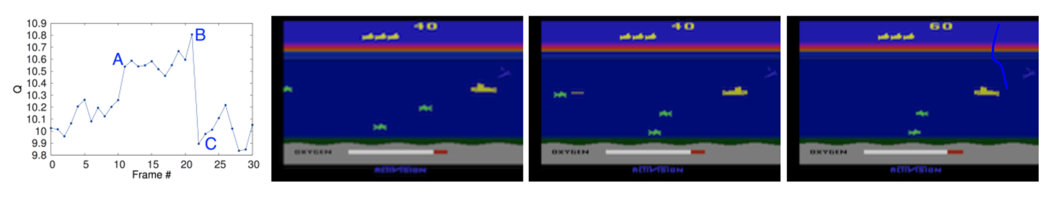
Visualising Q
A
B
C
Notes:
Seaquest
Predicted value jumps as enemy appears on left of screen (point A)
Predicted value peaks as torpedo is about to hit the enemy (point b)
Value falls back down after enemy is destroyed (point C)
Shows that we are predicting future reward

Slide 100
Problems with Q-Learning
Non MDP processes (state doesn’t contain entire useful history)
Can use LSTM
Long time horizons
Use search (ie MCTS in Alpha Go)
Requires simulator
Can use transfer learning (from GTA to self driving cars???)
https://www.youtube.com/watch?v=xWe58WGWmlk

Slide 101
Break

Slide 102
Recap – Q-Learning & Atari
SARSA = on policy
Q-Learning = off policy
Atari
End to end reinforcement learning
Reward clipping
Use of replay memory = breaks correlations, smooths behaviour distribution, more data efficient

Slide 103
Part Three Policy gradient methods

Slide 104
Policy methods
Previously we looked at generating a policy using a value function
Now we look at parametrizing a policy directly
change policy parameters to get more reward
Deterministic or stochastic policy
Why might a stochastic policy be ideal?
Notes:
Can sometimes be eaiser to represent a policy than a value function
Ie to work out that I’m going to get 4,315 units of reward is harder than just specifying the correct action from state s

Slide 105

Stochastic policy
Deterministic policy (ie always rock) is easily exploited!
Uniform random policy is optimal
Stochasticy in policy -> can deal with non-stationary environment
Helps exploration

Slide 106
Policy function
Discrete action space
output a vector of probabilities (ie softmax)
Continuous action space
output the mean & co-variance of Gaussian (essentially regression)
Deep Reinforcement Learning (John Schulman, OpenAI)
https://www.youtube.com/watch?v=PtAIh9KSnjo#t=47m58s
Policy gradient parameterized with a neural network

Slide 107
Why policy methods
Can be simpler to learn what to do vs learning how much return you will get from state s
Q-Learning considers the Q(s,a) for all possible a
suffers from curse of dimensionality in high dimensional state or action spaces
Optimize what we care about (the policy)
value function methods we optimize for the predictive power of the value function – not for the optimal action

Slide 108
Policy methods
Advantages
better convergence (no max!)
effective in high dimensional spaces
effective in continuous action spaces
can learn stochastic policies
can be more compact
easier to learn LSTM policies
Disadvantages
typically converge to local optimum
less sample efficient (extract less data than a value function)
evaluating policy is high variance
Notes:
Better convergence = because a small change in direction of optimal policy (don’t get the large swings that you can get in value based)
Guranteed to converge to at least local optimum (but typically do just that!)
Use of max in value function = not as effective in high dimensional or continuous policies (you take the max)
In policy you never need to solve for the max (only imcremental movements in direction of better policy)
MAX = aggressive. Also reason why value based converge faster/more efficient

Slide 109
How to optimize a policy
Starting at the end!
Loss = - log(probability(action_taken)) * return
Scale loss by the value of the return
shift policy parameters in the direction of maximising returns
change our policy to favour good actions
We have learnt about the different methods to estimate return (Monte Carlo, temporal difference...)
Notes:
Only needs to be differentialable where we want to take actions

Slide 110
How to optimize a policy
We have learnt about the different methods to estimate return
Monte Carlo = we used actual returns (observed)
Temporal difference, Q-Learning = use Bellman equation to estimate returns
Notes:
Only needs to be differentialable where we want to take actions

Slide 111
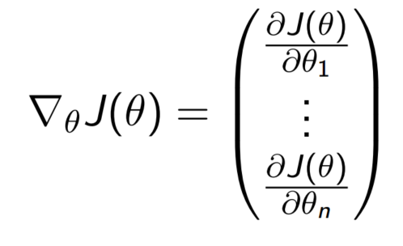
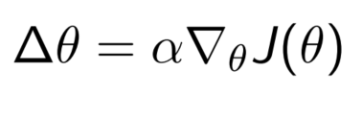
Policy objective functions
How do we measure the quality of our policy?
i.e. average reward per time step
Policy gradient is an optimization problem
1 - pick a policy quality measure
2 – find weights to maximize policy quality
Update parameters along the gradient
Can use any optimization algorithm
i.e. gradient descent
Notes:
Only needs to be differentialable where we want to take actions

Slide 112
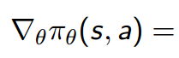
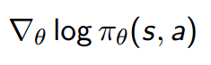
Score function
Likelihood ratios are used to develop the score function
Score function allows us to take expectations of the average/mean action
because we can sample from our policy
How to adjust policy in direction we think is good
i.e. to favour action a
gradient[policy]
gradient[log(policy)]
Notes:
Score function = unbiased sample of gradient.
Need to be able to compute the probability density and to be able to d/x wrt policy parameters.
Valid even if f(x) = discontinuous and unknown, or if sample space of x is discrete! Only need to be able to query the function.
Allows you to d/dx functions with non-differential features

Slide 113
Policy Gradient Theorem
$$∇_{θ}J\left(θ\right)=𝔼_{π} [∇_{θ}log⁡[π_{θ}\left(s,a\right)]∙Q^{π_{θ}}\left(s,a\right)]$$
Expectation for policy π
Gradient of the log of the policy
Discounted return for policy π from state s, taking action a
Note – θ = function parameters:
i.e. π_{θ}= policy π parameterized by weights θ
Notes:
Score function = unbiased sample of gradient.
Need to be able to compute the probability density and to be able to d/x wrt policy parameters.
Valid even if f(x) = discontinuous and unknown, or if sample space of x is discrete! Only need to be able to query the function.
Allows you to d/dx functions with non-differential features

Slide 114
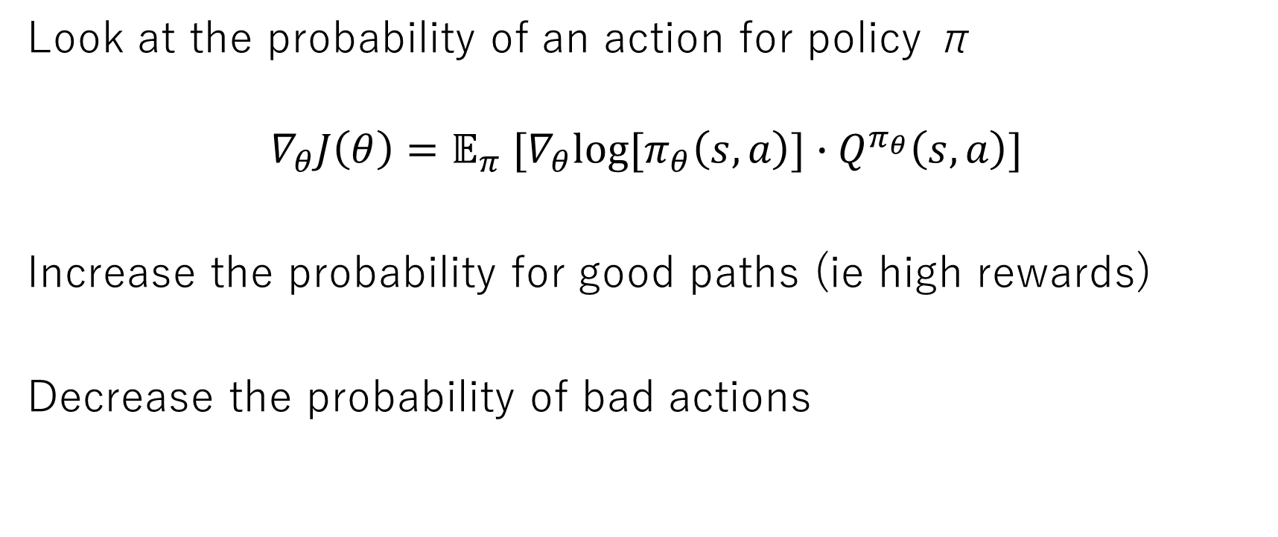
Policy gradient intuition
Look at the probability of an action for policy π
$$∇_{θ}J\left(θ\right)=𝔼_{π} [∇_{θ}log⁡[π_{θ}\left(s,a\right)]∙Q^{π_{θ}}\left(s,a\right)]$$
Increase the probability for good paths (ie high rewards)
Decrease the probability of bad actions
Notes:
Score function = unbiased sample of gradient.
Need to be able to compute the probability density and to be able to d/x wrt policy parameters.
Valid even if f(x) = discontinuous and unknown, or if sample space of x is discrete! Only need to be able to query the function.
Allows you to d/dx functions with non-differential features

Slide 115
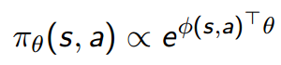
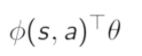

Linear softmax policy
Use softmax for discrete actions
Actions weighted using linear combination of features
Use score function to find the gradient
how much more of this feature
do I have than usual
action probability
exponential
feature for
action a
(action we took)
average feature for all possible a

Slide 116


Linear Gaussian policy
Use Gaussian for continuous actions
Mean weighted using linear combination of features
could also parameterize the variance
Use score function to find the gradient
how much more of this feature
do I have than usual
(action – mean) * feature / variance
Notes:
Both of these = how much more am I doing something

Slide 117

Monte-Carlo Policy Gradient
Use actual return as unbiased sample of Q(s,a)
Update parameters using stochastic gradient ascent
gradient[log(policy)] * sampled actual return

Slide 118

Monte Carlo Policy Gradient

Slide 119
Actor-Critic

Slide 120

Actor-Critic
Combination of value & policy methods
Maintain two parameterized functions
1 – Actor = parametrize a policy
2 – Critic = parameterize a value function Q_{w}(s,a)
We then update our policy in the direction suggested by critic
We follow an approximate policy gradient (as we use approximate value function)
Approximate using Monte Carlo, temporal difference etc.
Qπ – not Q* !
Notes:
Ie we don’t use actual sampled returns – we use our own value function
Approximating policy gradient = introduces bias. A carefully chosen value function approximator can avoid introducing any bias (ie we will follow the exact policy gradient)
MC = high variance (ie one episode we could do very well, next episode we do poorly)

Slide 121

Actor-Critic

Slide 122

Actor-Critic example
Actor (params= θ)
update using policy gradient
Critic (params=w)
update using linear TD(0)
TD error
improve policy (actor)
improve value function (critic)

Slide 123


Baseline
We can reduce variance using a baseline (without changing the expectation)
Using a baseline allows us to rewrite our policy gradient update using the advantage function
We now need to parameterize three functions (Q, V, π)!
Can also use an approximate TD error
Only one set of parameters
Notes:
Rescaling – rather than 99,100 we get -1,+1

Slide 124
Recap – Policy Gradient
High dimensional & continuous action spaces
Slower & more reliable convergence
Allow stochastic policies
Inefficient
High variance
Score function
Actor-Critic
use of a baseline to reduce variance

Slide 125
Summary
Value methods
harder to understand when they are going to work
less stable
more efficient (when they work)
learning value function and hoping it gives a good policy
Policy gradients
converge better
optimize what you care about directly
less efficient (smaller updates – less aggressive than the argmax)
Deep Reinforcement Learning (John Schulman, OpenAI)
https://www.youtube.com/watch?v=PtAIh9KSnjo

Slide 126

Summary
Adapted from
Deep Reinforcement Learning (John Schulman, OpenAI)
https://www.youtube.com/watch?v=PtAIh9KSnjo

Slide 127
Break

Slide 128

Literature review

Slide 129

AlphaGo
2015 - First computer to beat a human professional Lee Sedol
2017 - Beat world No.1 ranked player Ke Jie.

Slide 130
Why Go?
Long been viewed as the most challenging of the classic games for artificial intelligence
Massive search space – 1.74x10¹⁷² legal positions
Difficult to evaluate board positions & moves
Sparse & delayed reward
AlphaGo works to reduce both the depth and width of search
1 – width reduced by sampling high probability actions from a policy
2 – depth reduces through position evaluation using v(s)

Slide 131
Components of the AlphaGo agent
Three policy networks
fast rollout policy network – softmax linear function
supervised learning policy network – 13 layer convolutional NN
reinforcement learning policy network – same structure as SL network
One value function
predicts expected outcome of state s – v(s)
convolutional neural network
Combined together using Monte Carlo tree search

Slide 132


Learning process
1 – Train our fast & SL policy networks
predicting moves of human expert players (supervised learning)
2 – Train our RL policy network
initialize using SL policy network
self play – optimize to win (not predict moves)
3 – Train value function
use data generated during RL policy network self play
policy gradient update
value fctn update
z = game outcome
Notes:
Fast policy = 24% acc, 3 μs.
SL policy = 57% acc, 3ms.
Play games between policy network and randomly selected previous iteration of policy.
Randomization stabilizes, reduces variance.
RL policy alone (no search) = won more than 85% against strongest open source Go program Pachi.
Training value function:
Uses a randomly generated dataset all sampled from different games of self play using the policy network.
Ie it learns from data generated by the policy network.
Reduces variance.
Single evaluation of v(s) approached accuracy of MC rollouts using policy network

Slide 133

Learning process

Slide 134
Monte Carlo tree search
Planning can be used to
improve a policy/value function (i.e. Dynamic Programming)
but also for action selection
Run many simulated trajectories from our state s to episode end
trajectories simulated using the fast rollout policy
Value of a state-action pair Q(s,a) is estimated as the average of the simulated returns from that pair
track two statistics: 1 = visit count, 2 = number of wins
Move selected using these statistics

Slide 135

Monte Carlo tree search
Choose new node to simulate
Simulate to end of episode
Backup result to prior state

Slide 136

Monte Carlo tree search
Evaluate each node in two ways
1 – value function
2 – outcome of a random rollout using fast rollout policy
Combined using a mixing parameter lambda
We are mixing the full rollout with a one step rollout
Distributed version of AlphaGo
1,202 CPUs & 176 GPUs

Slide 137

AlphaGo move selection

Slide 138
AlphaGo move selection
Value function V(s)
Convolutional neural network
Show winning percentages for top moves

Slide 139
AlphaGo move selection
Q(s,a) using the value network
(λ= 0)
Q(s,a) using the rollouts
(λ=1)

Slide 140
AlphaGo move selection
Move probabilities generated using the Supervised Learning policy network

Slide 141
AlphaGo move selection
Frequency with which actions were selected from root during simulations

Slide 142
AlphaGo move selection
Numbers = path with maximum visit count from search tree
Final move selection
Selected
Fan Hui response
Alpha Go predict of response
Fan Hui later said he preferred Alpha Go’s prediction!

Slide 143
AlphaGo, in context – Andrej Karpathy (2017)
Convenient properties of Go
1 – fully deterministic
2 – fully observed
3 – discrete action space
4 – access to perfect simulator
5 – relatively short episodes
6 – evaluation is clear
7 – huge datasets of human play
8 – energy consumption (human ≈ 50 W)
https://medium.com/@karpathy/alphago-in-context-c47718cb95a5

Slide 144



Slide 145
DOTA 2 – Open AI
Learned Bot Behaviours
https://www.youtube.com/watch?v=wpa5wyutpGc&#t=00m00s
1v1 vs Arteezy
https://www.youtube.com/watch?v=rNSH8CviQQw&#t=00m00s

Slide 146

DOTA 2 – Open AI

Slide 147

DOTA 2 – Open AI
reward function design

Slide 148
Dota 2 – Open AI
Limited item selection
Used supervised learning to train a ‘creep block’ agent
creep blocking is a skill used to fight close to your own tower
5v5 is massively more challenging
but solving it feels inevitable...

Slide 149
thanks!

